Slide 1

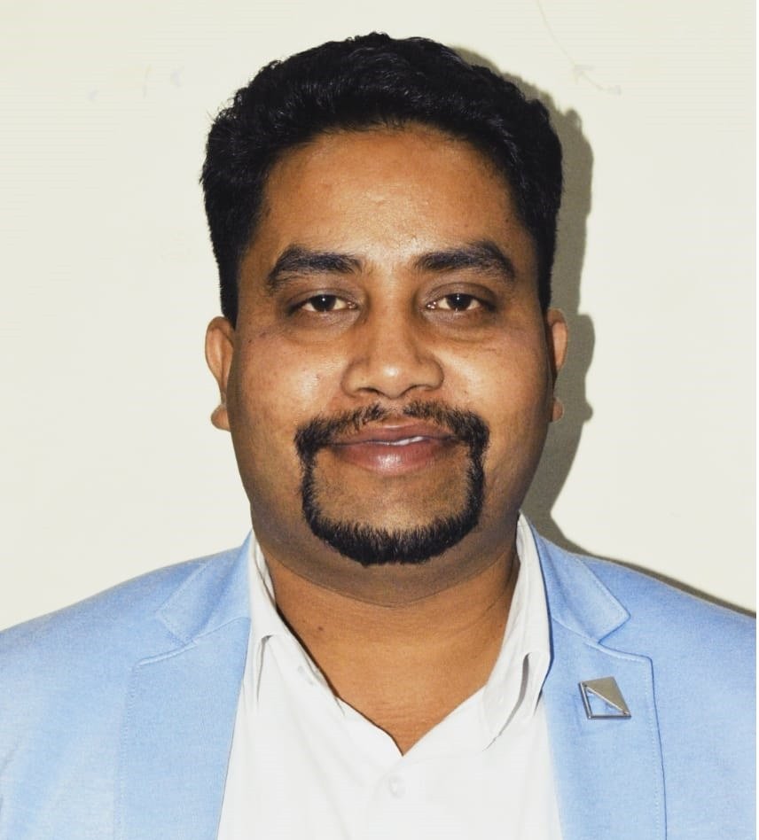
Robotic Process Automation using UiPath
Topic 4- Decisions, Iterations, and Scenarios in StudioX
HITESH KUMAR SHARMA
Technical Instructor & Consultant

Slide 2

Introduction to RPA
StudioX Citizen Developer Journey and Working with StudioX
Activity Recording, UI Automation in StudioX
Decisions, Iterations, and Scenarios in StudioX
File, Folder Automation in StudioX: Microsoft Excel Automation
Email & SAP Automation in StudioX
Handle Errors in StudioX
COURSE OBJECTIVES

Slide 3
4. Decisions, Iterations, and Scenarios in StudioX
If-the-else and Switch Activity
For Loop, For-each Loop and While Loop
Scenarios

Slide 4
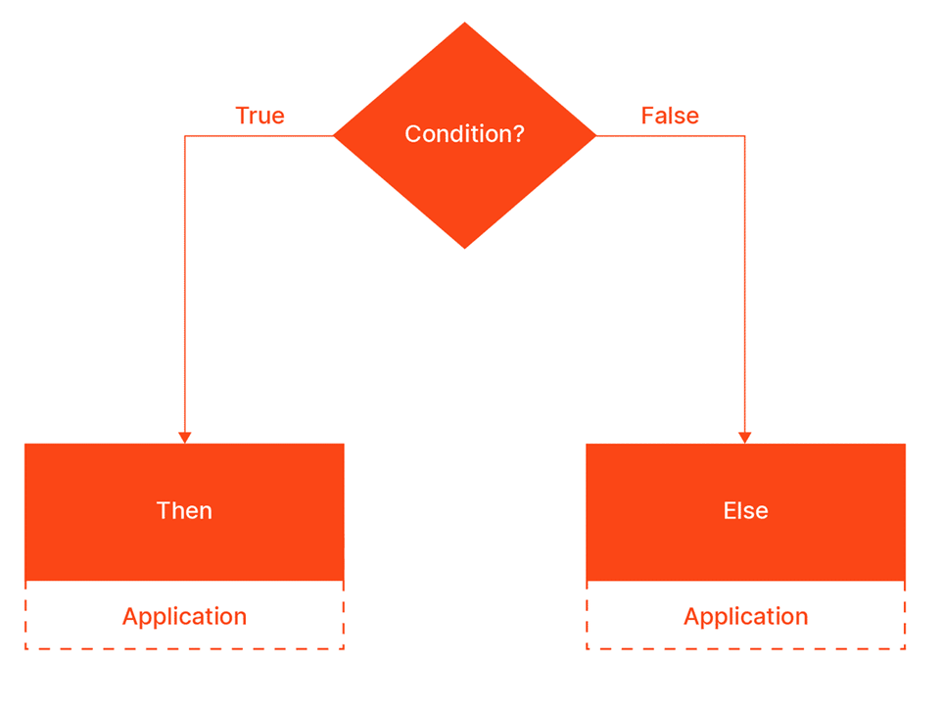
DECISIONS (If-the-else and Switch Activity)
When we speak about decisions in automation, we typically refer to finding a solution to a "True" (yes) or "False" (no) question that checks a condition. The robot is prompted to a course of action, based on whether the condition is met or not.
An example of that would be: "Is this credit request eligible?". If true, then the robot will have to perform a certain set of actions. If false, then the robot has another set of actions in store.

Slide 5
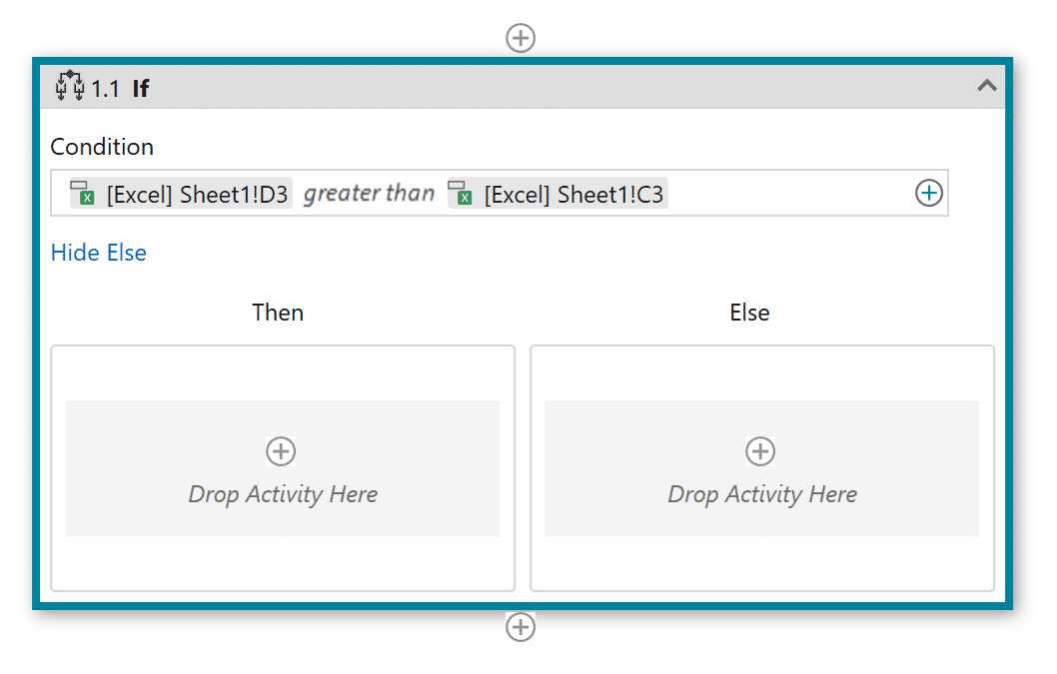
DECISIONS (If-the-else and Switch Activity)
The basic activity when it comes to decisions in automation is the If activity. You can find it under the Common activities in StudioX, as you can pair it with any resource available.
The If activity contains a statement or condition - what we have referred to as the question, and two branches. In the given example, the branches are the two courses of action the robot can take, depending on the characteristics of the statement. Is it true (yes - Then) or is it false (no - Else)?
Let's assume all the credit requests are stored in a spreadsheet and the eligibility criterion is a threshold calculated in another cell.
How do we translate this to the robot?
If cell D3 (request value) is greater than cell C3 (threshold), then do..., else do...

Slide 6
DECISIONS (If-the-else and Switch Activity)
(Hands-on)
Let's now take another example and slip into the shoes of Jude, our Financial Clerk. Their task is to make sure all transactions in a spreadsheet are processed with the help of the Double UI dummy bank teller app. Sounds familiar? Well, there's a catch! This time, Jude has received a number of documented transactions, only some are processed, some are not.
In developing the automation you'll use the following input files, websites, and applications:
The "Transactions - May2022" spreadsheet - all transactions are documented here.
The Double UI app - this is the transaction processing tool.

Slide 7
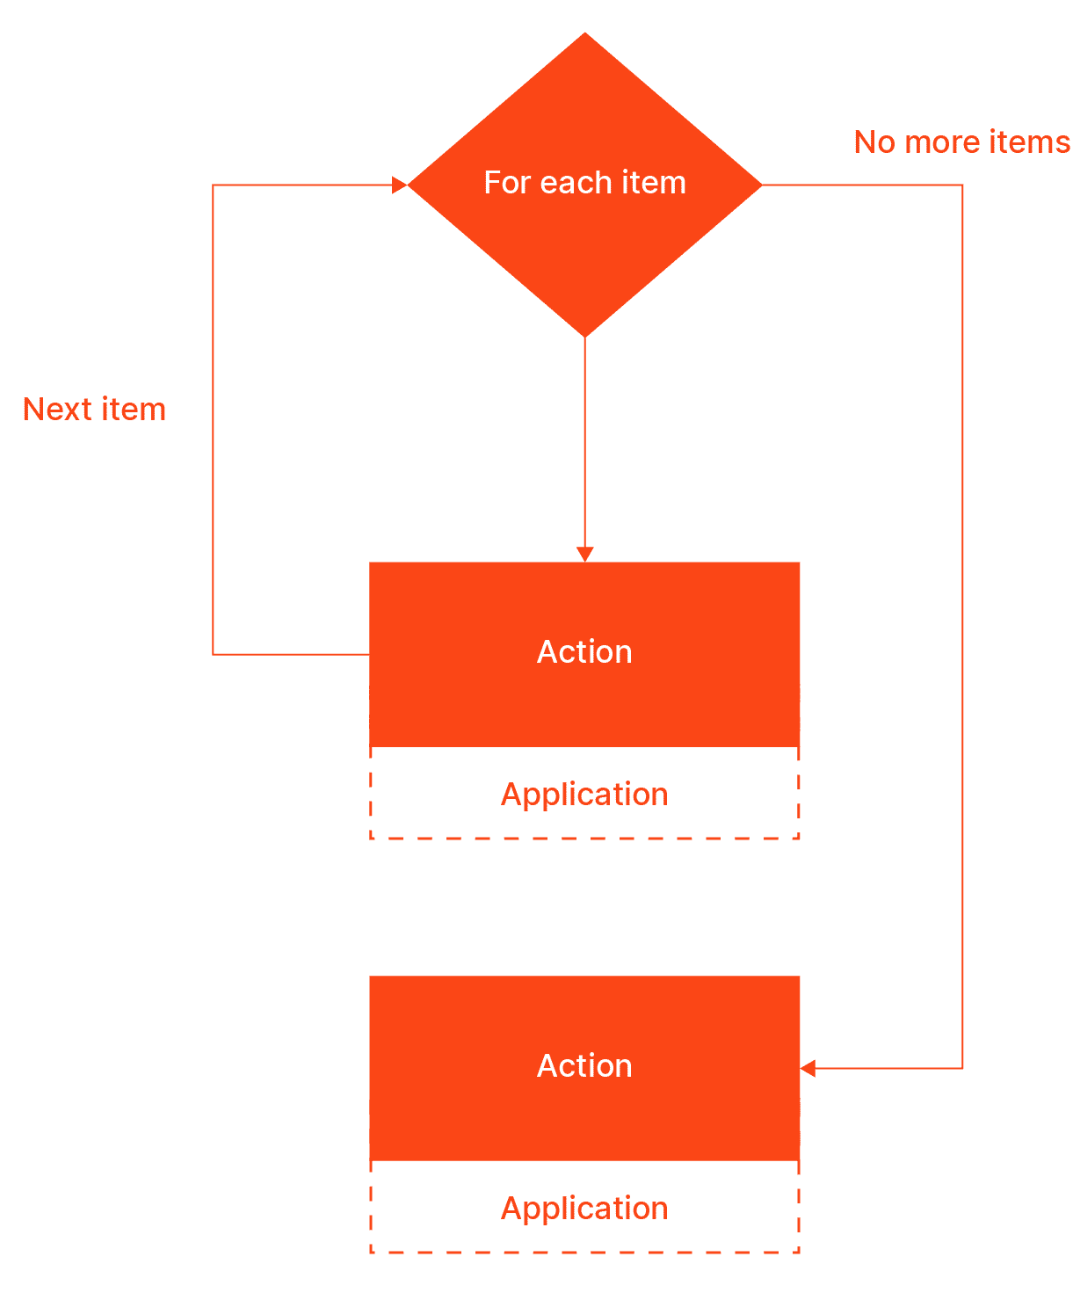
ITERATIONS (For Loop, For-each Loop and While Loop )
Iterations in automation are repeating sets of steps that help users automate complete tasks. Many of the daily tasks any employee faces include at least an iteration.
Let's circle back to the example with the credit requests. The robot had to decide in the previous lesson whether the credit request was eligible or not. At the present moment, there are over 300 credit requests in the backlog.
How can we process them all without adding as many If activities?
With a For Each activity! This way, the automation will go through each credit request there is in the indicated space.

Slide 8
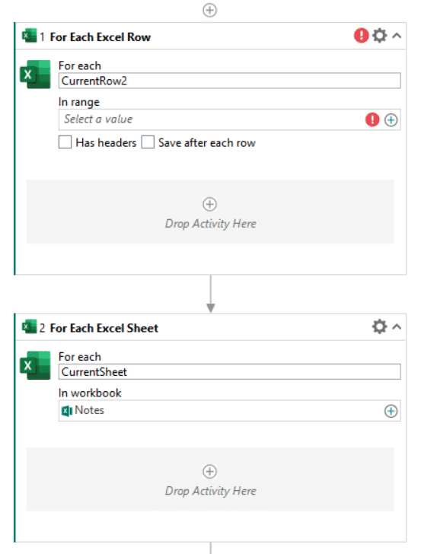
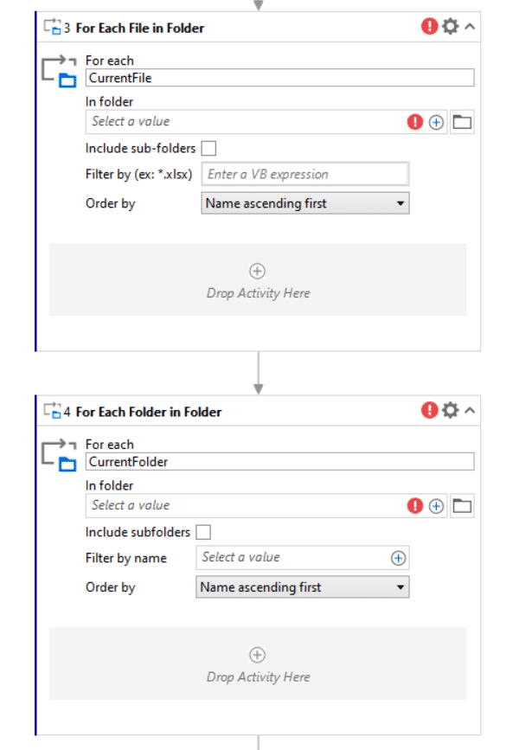
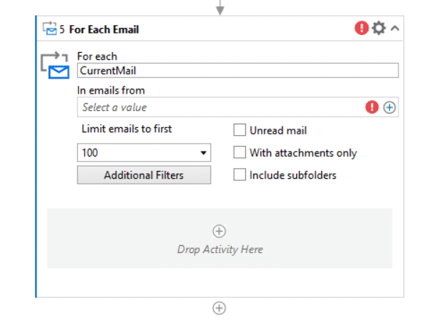
ITERATIONS (For Loop, For-each Loop and While Loop )
Excel
For Each Excel Row
For Each Excel Sheet
File/Folder
For Each File in Folder
For Each Folder in Folder
Email
For Each Email

Slide 9
ITERATIONS (For Loop, For-each Loop and While Loop )
(Hands-on)
For that, we'll return to Jude's task: making sure all transactions in a spreadsheet are processed with the help of the Double UI dummy bank teller app. In the previous lesson, you discovered how to process the first transaction, avoiding double-work. In this one, you'll see how you can make the automation repeat those steps for every transaction documented in the spreadsheet. You will build up on the workflow you've already created for the previous lesson. And you'll be making use of a For Each activity.
In developing the automation you'll use the following input files, websites, and applications:
The "Transactions - May2022" spreadsheet - all transactions are documented here.
The Double UI app - this is the transaction processing tool.

Slide 10
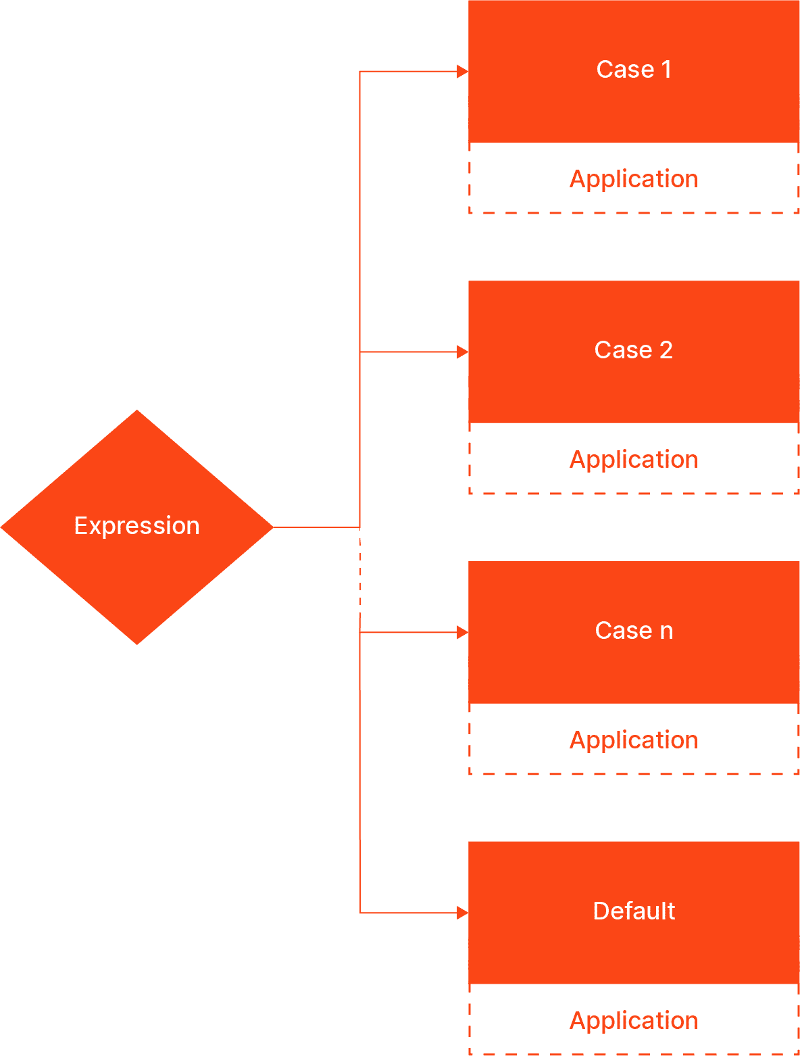
SCENARIOS
If the word "scenarios" makes you think about different cases or courses of action one might take, you're on the right path! Scenarios in automation describe different cases defined by an expression, in which the robot takes the proper steps.
For instance, after having decided which credit requests are eligible, there are several scenarios that can take place, depending on a given criterion.
In this situation, the transactions are classified into 3 categories that follow different processing protocols:
Fast Approval: a robot compares the request information against a checklist, and then it approves the credit if the request meets all the requirements.
Due Diligence: a robot writes the request information in another document and sends it to the Loan Officers team.
Upper Level: a robot writes the request information in another document and sends it to the Credit Administration team.

Slide 11
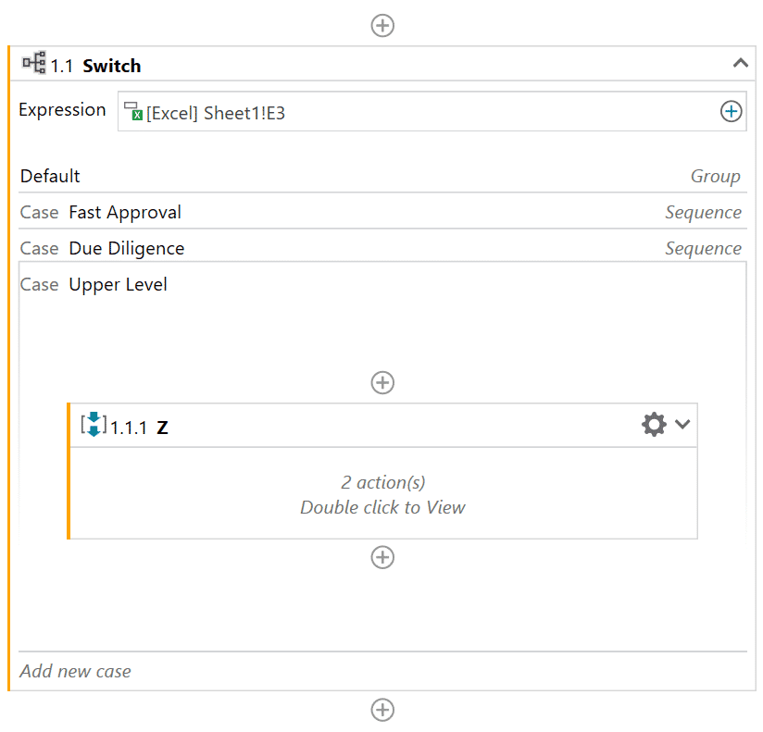
SCENARIOS
When configuring the Switch activity, the expression will be the Category, and the cases will be the expression's values: Fast Approval, Due Diligence, Upper Level, and Default.
The Default case corresponds to any value other than the ones defined, for instance: Pending, Needs Attention, SOS or bananas.
Within each case, there are steps to be followed.

Slide 12
SCENARIOS (Hands-on)
Switching to Jude's situation, things have recently changed. They must now process several types of transactions, with different steps to be executed.
Using the Switch activity, you will define a case for each transaction type, indicating the different courses of action the robot must take to accomplish Jude's task.
In developing the automation you'll use the following input files, websites, and applications:
The "Total transactions - May2022" spreadsheet - all transactions are documented here.
The Double UI app - this is the transaction processing tool.

Slide 13
TOPIC 4
END
THANK YOU

